Slide 1
Assistance for Impaired People
Guide:
Mrs.Vijayalakshmi
N.Divya(211419104071)
R.Dhanvarshini(211419104060)

Slide 2
INTRODUCTION
We came up with an Integrated Machine Learning System which allows the Visually Impaired Victims to identify and classify Real Time Based Common day-to-day Objects.
We also generate voice feedbacks and calculates distance which produces warnings whether he/she is very close or far away from the object.
The same system can be used for Obstacle Detection Mechanism.

Slide 3
LITERATURE SURVEY
S.No | TITLE OF THE REFERENCE | YEAR | PUBLICATION | LINKS
1. | Blind assist system | 2020 | International Journal of Advanced Research in Computer and Communication Engineering | https://medium.com/beingryaan/real-time-object-detection-along-with-distance-and-voice-alerts-for-blinds-a-blind-assistance-1708b97c3ecc
2. | Vission-Based System for Assisting Blind People To Wander Unknown Environment in a Safe Way | 2021 | Eduard Llobet, Research paper | https://www.hindawi.com/journals/js/2021/6685686/

Slide 4
S.No | TITLE OF THE REFERENCE | YEAR | PUBLICATION | LINKS
3. | An Implementation of an Intelligent Assistance System for Visually Impaired/Blind People | 2019 | 2019 IEEE International Conference on Consumer Electronics (ICCE) | https://ieeexplore.ieee.org/document/8661943
4. | Blind Assistance Device using AI | 2021 | International Journal Of Engineering Research&Technology(IJERT) | https://www.ijert.org/blind-assistance-device-using-ai

Slide 5
PROBLEM STATEMENT
Environment challenges:
It’s a known fact that estimated number of visually impaired person in the world is about 285 million, approximately equal to the 20% of the Indian Population.
People who are completely blind or have impaired vision usually have a difficult time navigating outside the spaces that they're accustomed to. physical movement is one of the biggest challenges for blind people. Traveling or merely walking down a crowded street can be challenging.
many people with low vision will prefer to travel with a sighted friend or family member when navigating unfamiliar places.Also, blind people must memorize the location of every obstacle or item in their home environment. Objects like beds, tables and chairs must not be moved without warning to prevent accidents. If a blind person lives with others, each member of the household has to be diligently about keeping walkways clear and all items in their designated locations.
The existing system consists of
object detection
device sensor
braille system
voiceover.
The existing system does help the visually impaired people to navigate easily. But the aren’t aware of the objects description and their distance.
And there is no feedback about the object detected.

Slide 6
hardware
Laptop
Camera/web cam
SOFTWARE
STACKOVERFLOW
ANACONDA
SYDER
PYTHON
TENSORFLOW APIs

Slide 7
TensorFlow Object Detection API depends on the following libraries:
Protobuf 3.0.0
Python-tk
Pillow 1.0
lxml
tf-slim
slim
Jupyter notebook
Matplotlib
Tensorflow (1.15.0)
Cython
contextlib2
cocoapi

Slide 8
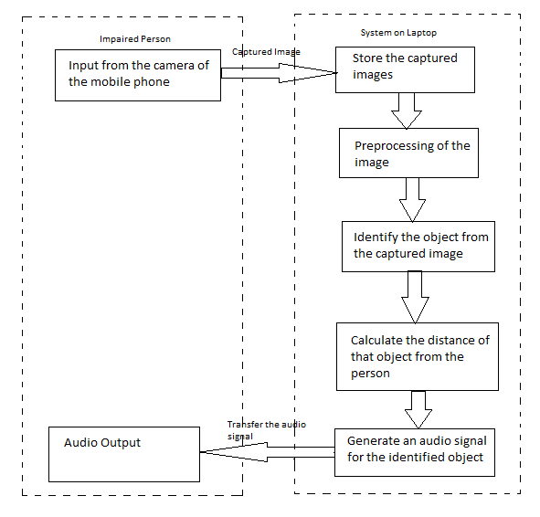
System Architecture

Slide 9
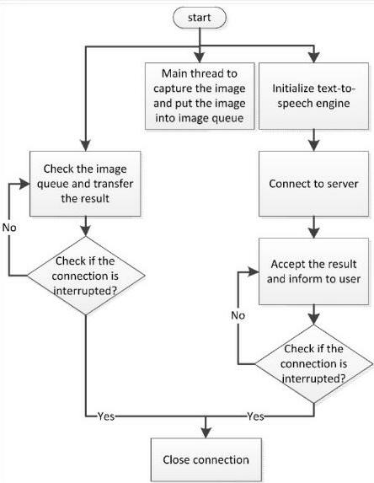
SYSTEM DESIGN
Dataflow diagram

Slide 10
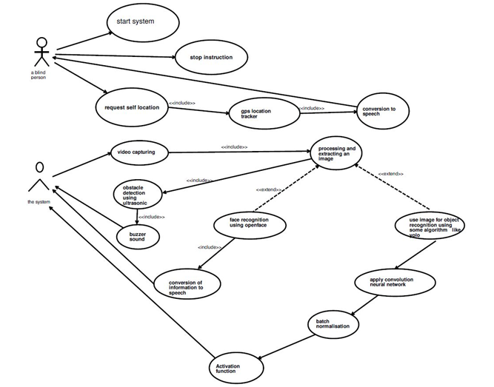
Use case Diagram

Slide 11
Module Description
SSD ALGORITHM
OBJECT DETECTION
DEPTH ESTIMATION
VOICE GENERATION
MOBILENET

Slide 12
TESTING
1) At first, we are capturing real time images from system laptop and then connection is made between those images from the camera to laptop. 2)This connection is done by a software installed in the laptop. All the real time images which get captured by the camera of the laptop are first transferred to the software in the laptop and then those images which are sent in laptop , are processed for some further conclusions.

Slide 13
3) The system in laptop will test it using its APIs and SSD ALGORITHM and it detects the confidence accuracy of the image which it is testing. We reached 98% accuracy for certain classes like books, cups, remote. 4) After testing the images we are generating an output on the laptop based system and its prediction is being translated into voice with voice modules and sent to the blind person with the help of wireless audio support tools.

Slide 14
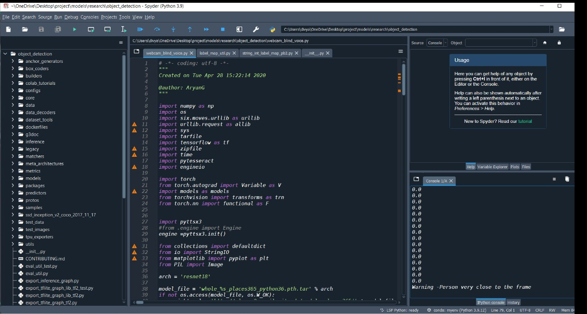
Screenshots

Slide 15
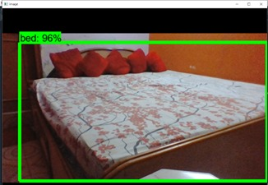

Slide 16
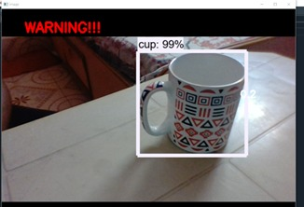

Slide 17
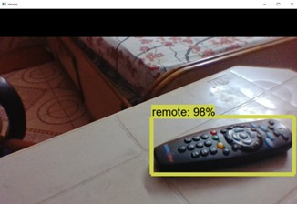

Slide 18
Conclusion
Several technologies have been created to aid visually impaired persons. One such attempt is that we would wish to make an Integrated Machine Learning System that allows the blind victims to identify and classify real-time objects generating voice feedback and distance. Which also produces warnings whether they are very close or far away from the thing. For visually blind folks, this technology gives voice direction. This technique has been introduced specifically to assist blind individuals. The precision, on the other hand, can be improved. Furthermore, the current system is based on the Android operating system; it can be altered to work with any device that is convenient.

Slide 19
Reference
[1] Choi D., and Kim M. (2018). Trends on Object DetectionTechniques Based on Deep Learning, Electronics and Telecommunications Trends, 33(4): 23-32.
[2] Dai Jet al., (2016). R-FCN: Object Detection via Region-based Fully Convolutional Networks. Conf. NeuralInform. Process. Syst.,Barcelona,Spain,Dec. 4-6, p. 379-387.
[3] Dalal N. and Triggs B., Histograms of oriented gradients for Human Detection (2015). IEEE Comput. Soc.Conf. Comput. Vision Pattern Recogn.,San Diego, CA, USA, June 20-25, p. 886-893.
[4] Russakovsky O et al., (2015). ImageNet Large Scale Visual Recognition Challenge, Int..J.Comput. Vision, 115(3): 211-252.
[5] Rajeshvaree Ravindra Karmarkar (2021). Object Detection System for the Blind with Voice Guidance, International Journal of Engineering Applied Sciences and Technology,6(2): 67-70.

